Slide 1
Chapter 2:
Diode Applications

Slide 2
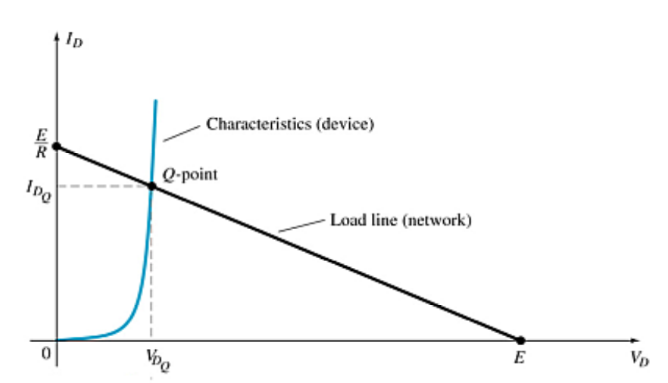
Load-Line Analysis
The load line plots all possible combinations of diode current (I_{D}) and voltage (V_{D}) for a given circuit. The maximum I_{D} equals E/R, and the maximum V_{D} equals E.
The point where the load line and the characteristic curve intersect is the Q-point, which identifies I_{D} and V_{D} for a particular diode in a given circuit.

Slide 3
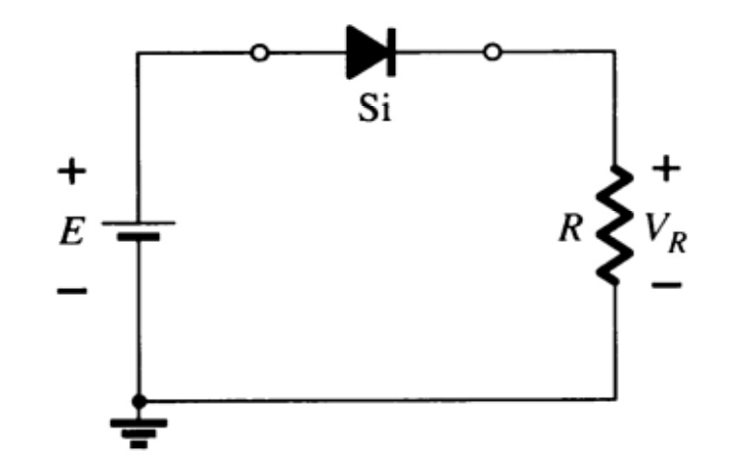
Series Diode Configurations
Forward Bias
Constants
Silicon Diode: V_{D} = 0.7 V
Germanium Diode: V_{D} = 0.3 V
Analysis (for silicon)
V_{D} = 0.7 V (or V_{D} = E if E < 0.7 V)
V_{R} = E – V_{D}
I_{D} = I_{R} = I_{T} = V_{R} / R

Slide 4
Series Diode Configurations
Reverse Bias
Diodes ideally behave as open circuits
Analysis
V_{D} = E
V_{R} = 0 V
I_{D} = 0 A

Slide 5

Series diode:
Determine I, V1, V2, and Vo for the series dc configuration of
Figure below :

Slide 6


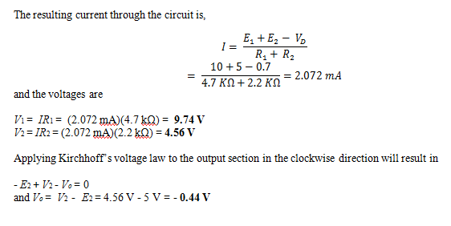
Continued

Slide 7
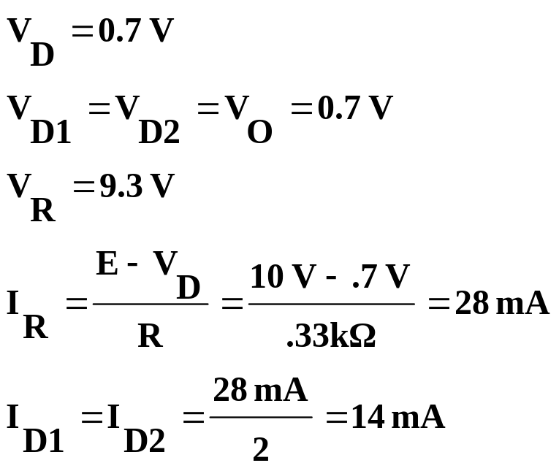
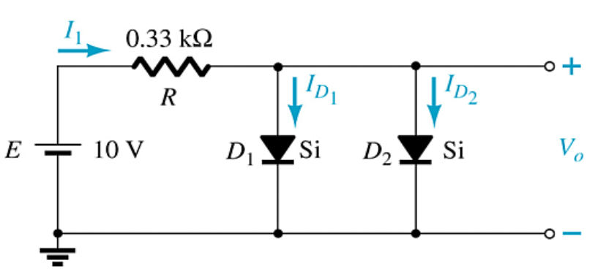
Parallel Configurations

Slide 8
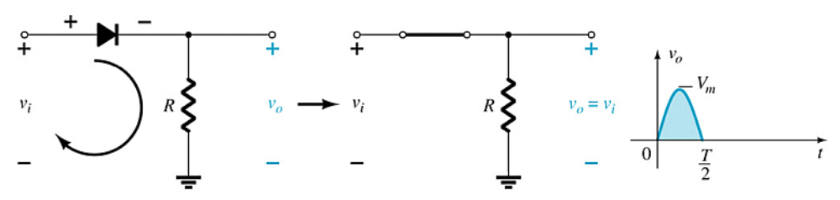
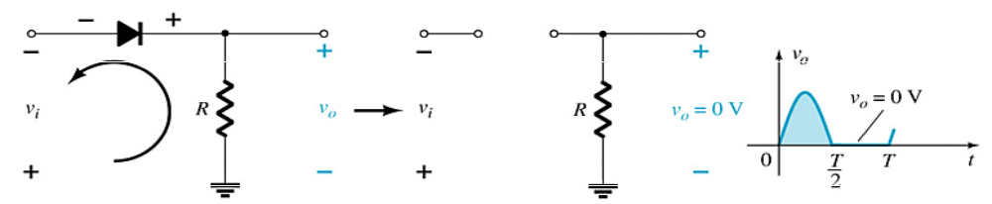
Half-Wave Rectification
The diode only conducts when it is forward biased, therefore only half of the AC cycle passes through the diode to the output.
The DC output voltage is 0.318V_{m}, where V_{m} = the peak AC voltage.

Slide 9
PIV (PRV)
Because the diode is only forward biased for one-half of the AC cycle, it is also reverse biased for one-half cycle.
It is important that the reverse breakdown voltage rating of the diode be high enough to withstand the peak, reverse-biasing AC voltage.
      PIV (or PRV) > V_{m}
PIV = Peak inverse voltage
PRV = Peak reverse voltage
V_{m} = Peak AC voltage

Slide 10
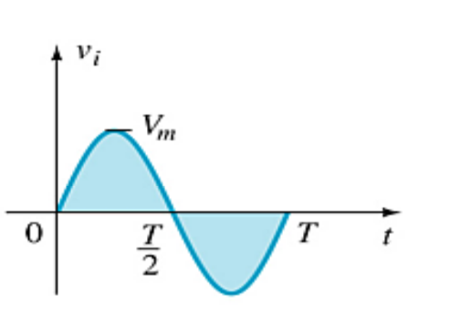
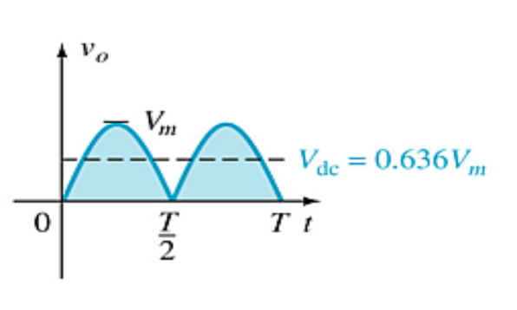
Full-Wave Rectification
The rectification process can be improved by using a full-wave rectifier circuit.
Full-wave rectification produces a greater DC output:
  Half-wave: V_{dc} = 0.318V_{m}
  Full-wave: V_{dc} = 0.636V_{m}

Slide 11
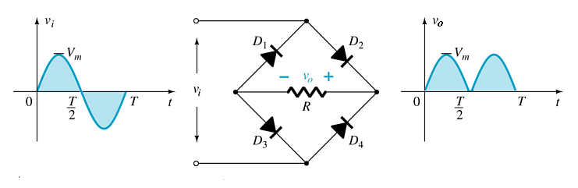
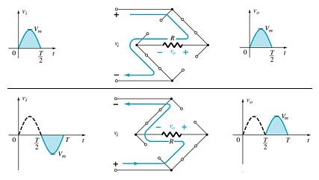
Full-Wave Rectification
Bridge Rectifier
Four diodes are connected in a bridge configuration
V_{DC} = 0.636V_{m}

Slide 12
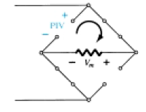
PIV
The required PIV of each diode (ideal) can be determined from Fig. above obtained at the peak of the positive region of the input signal. For the indicated loop the maximum voltage across R is Vm and the PIV rating is defined by
PIV >= Vm

Slide 13
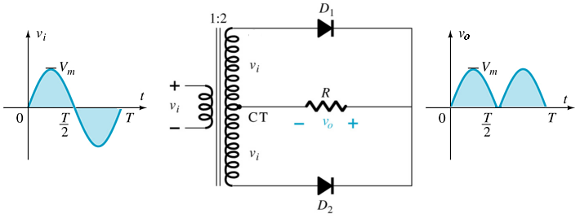
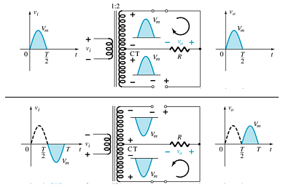
Full-Wave Rectification
Center-Tapped Transformer Rectifier
Requires
  Two diodes
  Center-tapped transformer
    V_{DC} = 0.636V_{m}

Slide 14
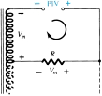
PIV
PIV = Vsecondary + V_{R}
= Vm + Vm
and PIV >= 2Vm CT transformer, full-wave rectifier

Slide 15
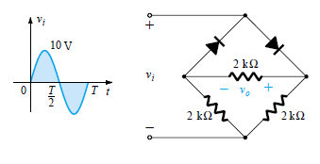
Problem : Determine the output waveform for the network of Fig. below and calculate the output dc level and the required PIV of each diode.

Slide 16
Summary of Rectifier Circuits
Rectifier | Ideal V_{DC} | Realistic V_{DC}
Half Wave Rectifier | V_{DC} = 0.318V_{m} | V_{DC} = 0.318V_{m} – 0.7
Bridge Rectifier | V_{DC} = 0.636V_{m} | V_{DC} = 0.636V_{m} – 2(0.7 V)
Center-Tapped Transformer Rectifier | V_{DC} = 0.636V_{m} | V_{DC} = 0.636V_{m} – 0.7 V
V_{m} = peak of the AC voltage.
In the center tapped transformer rectifier circuit, the peak AC voltage is the transformer secondary voltage to the tap.

Slide 17
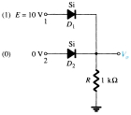
AND/OR GATES

Slide 18
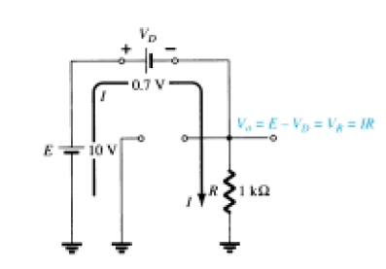

OR Gate:

Slide 19
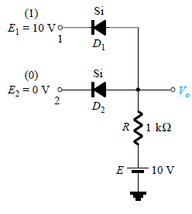
AND GATE:

Slide 20
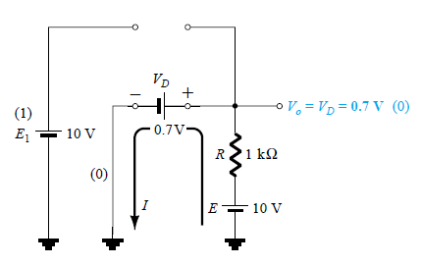

AND GATE:

Slide 21
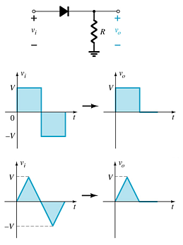
Diode Clippers
The diode in a series clipper “clips” any voltage that does not forward bias it:
A reverse-biasing polarity
A forward-biasing polarity less than 0.7 V (for a silicon diode)

Slide 22
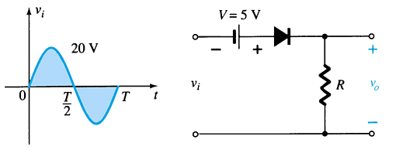
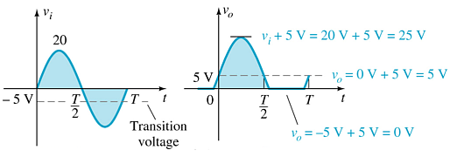
Biased Clippers
Adding a DC source in series with the clipping diode changes the effective forward bias of the diode.

Slide 23
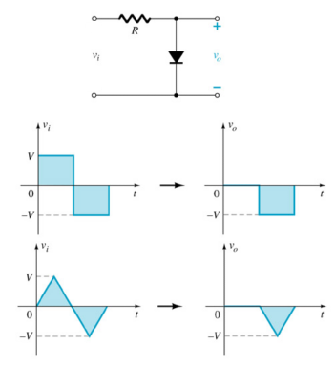
Parallel Clippers
The diode in a parallel clipper circuit “clips” any voltage that forward bias it.
DC biasing can be added in series with the diode to change the clipping level.

Slide 24
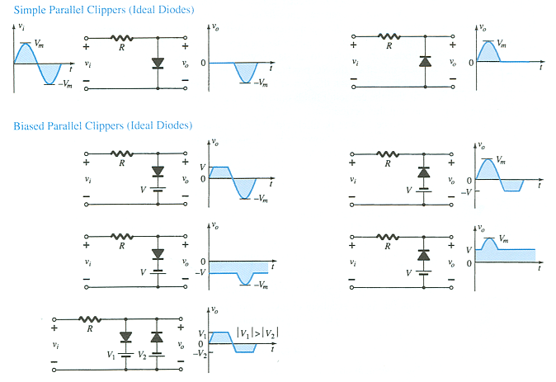
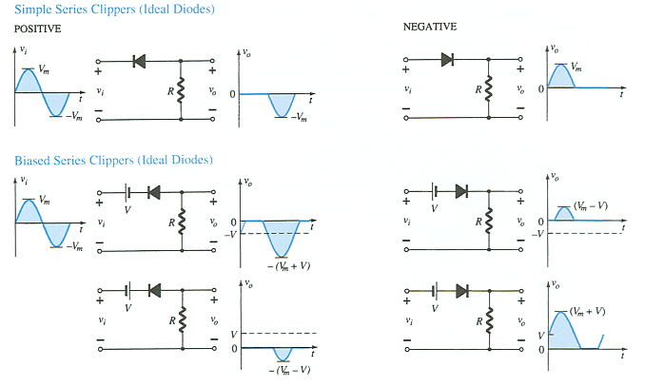
Summary of Clipper Circuits
more…

Slide 25
Summary of Clipper Circuits

Slide 26
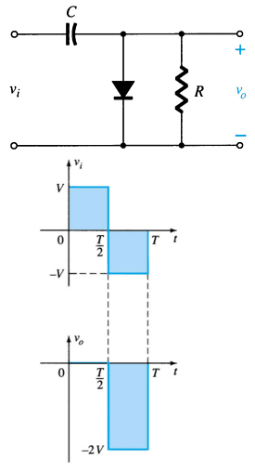
Clampers
A diode and capacitor can be combined to “clamp” an AC signal to a specific DC level.

Slide 27
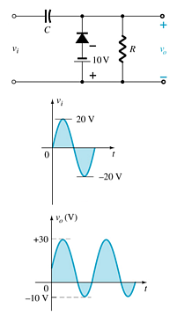
Biased Clamper Circuits
The input signal can be any type of waveform such as sine, square, and triangle waves.
The DC source lets you adjust the DC camping level.

Slide 28
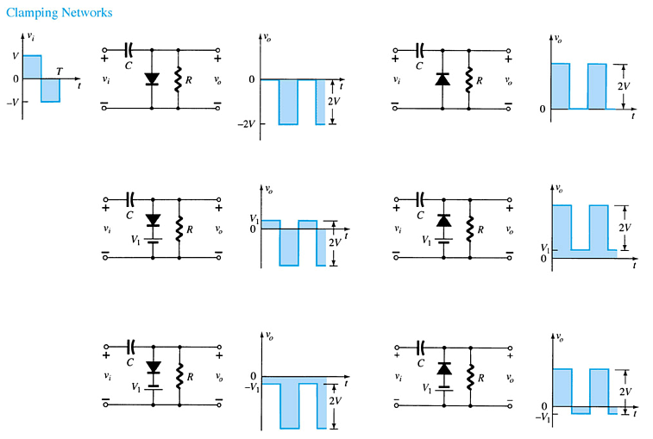
Summary of Clamper Circuits

Slide 29
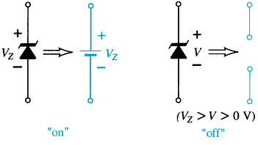
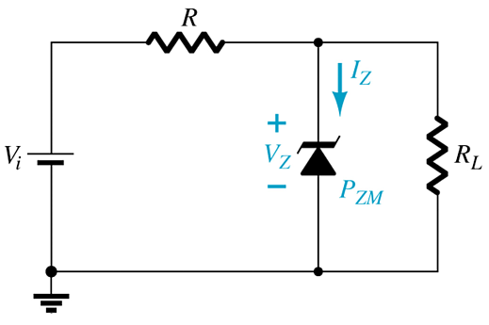
Zener Diodes
The Zener is a diode operated in reverse bias at the Zener Voltage (V_{z}).
When V_{i} ≥ V_{Z}
  The Zener is on
  Voltage across the Zener is V_{Z}
  Zener current: I_{Z} = I_{R} – I_{RL}
  The Zener Power: P_{Z} = V_{Z}I_{Z}
When V_{i} < V_{Z}
  The Zener is off
  The Zener acts as an open circuit

Slide 30

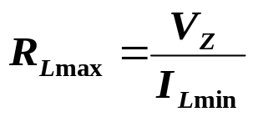
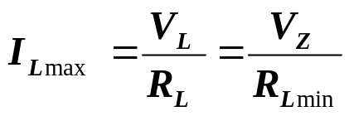
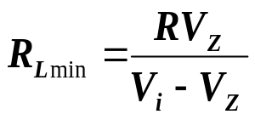
Zener Resistor Values
If R is too large, the Zener diode cannot conduct because the available amount of current is less than the minimum current rating, I_{ZK}. The minimum current is given by:
The maximum value of resistance is:
If R is too small, the Zener current exceeds the maximum current rating, I_{ZM} . The maximum current for the circuit is given by:
The minimum value of resistance is:

Slide 31


Fixed Vi and R
Determine the state of the Zener diode by removing it from the network and calculating the voltage across the resulting open circuit.
Substitute the appropriate equivalent circuit and solve for the desired unknowns.

Slide 32
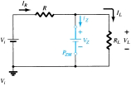
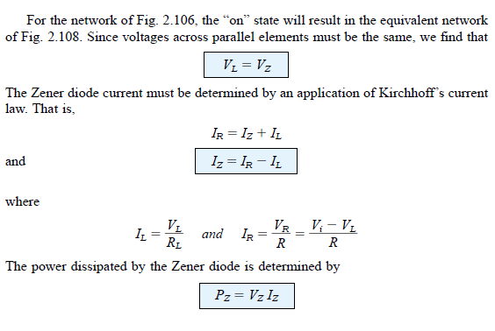

Slide 33
Voltage-Multiplier Circuits
Voltage multiplier circuits use a combination of diodes and capacitors to step up the output voltage of rectifier circuits.
Voltage Doubler
Voltage Tripler
Voltage Quadrupler

Slide 34
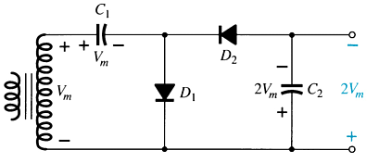
Voltage Doubler
This half-wave voltage doubler’s output can be calculated by:
    V_{out} = V_{C2} = 2V_{m}
  where V_{m} = peak secondary voltage of the transformer

Slide 35
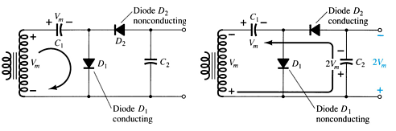
Voltage Doubler
Positive Half-Cycle
  D₁ conducts
  D₂ is switched off
  Capacitor C₁ charges to V_{m}
Negative Half-Cycle
  D₁ is switched off
  D₂ conducts
  Capacitor C₂ charges to V_{m}
V_{out} = V_{C2} = 2V_{m}

Slide 36
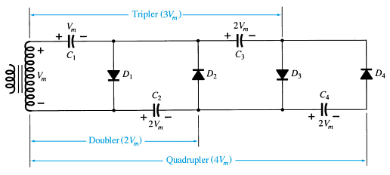
Voltage Tripler and Quadrupler

Slide 37
Practical Applications
Rectifier Circuits
  Conversions of AC to DC for DC operated circuits
  Battery Charging Circuits
Simple Diode Circuits
  Protective Circuits against
  Overcurrent
  Polarity Reversal
  Currents caused by an inductive kick in a relay circuit
Zener Circuits
  Overvoltage Protection
  Setting Reference Voltages

